Slide 1
Pemrograman Berbasis Web
Pertemuan 5
Nori Wilantika
Lya Hulliyyatus Suadaa
Yeni Rimawati
Politeknik Statistika STIS
Prodi DIV Komputasi Statistik

Slide 2
05
CLIENT-SIDE SCRIPTING (1) Javascript;

Slide 3
PENGENALAN
HTML/CSS cukup (sufficient) untuk dokumen HTML yang bertujuan untuk mendiseminasikan informasi yang tidak sering berubah.
Dokumen HTML yang tetap sama setiap kali diakses disebut static web pages. HTML/CSS cukup (sufficient) untuk static web pages.
Untuk mengembangkan halaman web interaktif / reaktif, kita harus mengintegrasikan pemrograman dalam beberapa bentuk atau lainnya
JavaScript adalah salah satu dari 3 bahasa yang harus dipelajari semua pengembang web :
HTML untuk mendefinisikan konten halaman web
CSS untuk menentukan tata letak halaman web
JavaScript untuk memprogram perilaku halaman web
Notes:
JavaScript Dapat Mengubah Konten HTML
JavaScript Dapat Mengubah Nilai Atribut HTML
JavaScript Dapat Mengubah Gaya HTML (CSS)
JavaScript Dapat Menyembunyikan/Menampilkan Elemen HTML
DEMO

Slide 4
PENGENALAN
JavaScript adalah bahasa untuk client-side scripting, yang pertama kali dikembangkan oleh Brendan Eich di Netscape.
Script code di-embed dalam web page dan dikirimkan ke client sebagai bagian dari web page and executed by the user's web browser.
Memungkinkan interaktivitas yang lebih baik dibandingkan dengan to server-side scripting karena reaction time ditingkatkan dan pertukaran data dengan server dapat diminimalkan.
A web browser mungkin tidak mendukung JavaScript atau pengguna mungkin tidak mengizinkan eksekusi kode JavaScript. Performa bergantung pada efisiensi JavaScript engine dan client's computing power.
Notes:
Mesin JavaScript yang berbeda dapat memberikan hasil yang berbeda, khususnya, hasil yang tidak diantisipasi oleh pengembang kode JavaScript

Slide 5

https://medium.com/@natashabibbs10/intro-to-html-css-and-javascript-d92d9b6845de
Notes:
https://medium.com/@natashabibbs10/intro-to-html-css-and-javascript-d92d9b6845de

Slide 6
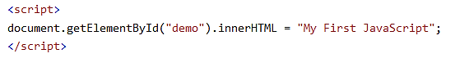
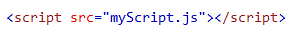
PENULISAN
Dalam HTML, kode JavaScript disisipkan di antara tag <script> dan </script>.
Skrip dapat ditempatkan di <body>, atau di <head>, atau di keduanya.
Skrip juga dapat ditempatkan di file eksternal, dengan ekstensi .js. Untuk menggunakan skrip eksternal, masukkan nama file skrip di atribut src.
A JavaScript script consists of one or more statements and comments, end in a semicolon.

Slide 7
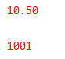
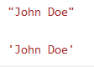
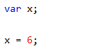
SYNTAX
Literals: Numbers and String
Variable
JavaScript menggunakan kata kunci var untuk mendeklarasikan variabel. Tanda sama dengan digunakan untuk menetapkan nilai ke variabel.
Operator
JavaScript menggunakan operator aritmatika ( + - * /) untuk menghitung nilai

Slide 8
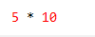
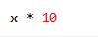
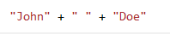
SYNTAX
Expression
Ekspresi adalah kombinasi nilai, variabel, dan operator, yang dihitung menjadi nilai.
Keywords
Digunakan untuk mengidentifikasi tindakan yang akan dilakukan. Kata kunci var digunakan untuk memberi tahu browser untuk membuat variabel.
Comments
Kode setelah garis miring ganda // (komentar baris tunggal) atau di antara /* dan */ (komentar multi baris) diperlakukan sebagai komentar.
Notes:
Dalam contoh ini, x didefinisikan sebagai variabel. Kemudian, x diberikan (diberikan) nilai 6:

Slide 9
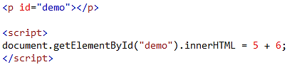
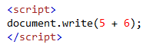
OUTPUT
JavaScript dapat menampilkan data dengan berbagai cara:
Menulis ke dalam elemen HTML, menggunakan innerHTML.
Menulis ke dalam output HTML menggunakan document.write().
Notes:
Statically typed programming language: Type checking is performed before program execution, e.g., by a compiler
Strongly typed programming language: Each value has exactly one type and operations can only be applied to argument values of the correct type

Slide 10
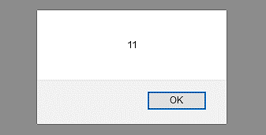
OUTPUT
JavaScript dapat menampilkan data dengan berbagai cara:
Menulis ke dalam kotak peringatan, menggunakan window.alert().
Menulis ke konsol browser, menggunakan console.log().
Notes:
Statically typed programming language: Type checking is performed before program execution, e.g., by a compiler
Strongly typed programming language: Each value has exactly one type and operations can only be applied to argument values of the correct type

Slide 11
DATA TYPE

Slide 12
DATA TYPE
Dalam pemrograman, tipe data merupakan konsep penting.
Untuk dapat mengoperasikan variabel, penting untuk mengetahui sesuatu tentang tipenya
Primitive Data Type: suatu nilai data sederhana tanpa properti dan metode tambahan, yaitu Boolean, number, string, undefined
Complex Data Type: null, function, array, object.

Slide 13
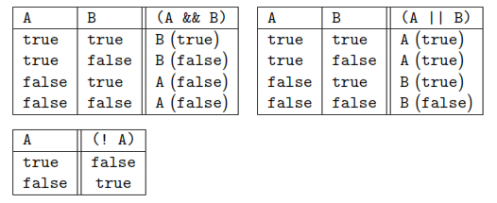
BOOLEAN
Boolean JavaScript mewakili salah satu dari dua nilai: benar atau salah.
JavaScript offers the following boolean operators:
&& (conjunction) || (disjunction) ! (negation)
The truth tables for the boolean operators are as follows:

Slide 14
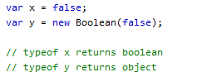
BOOLEAN
Segala Sesuatu dengan "Nilai" bernilai True.
100 3.14 -15
“Hello” “false” 7+1+3.14
Sebaliknya, segala sesuatu tanpa "Nilai" bernilai False.
0 -0 “ “
undefined null false NaN
Properties: constructor, prototype
Methods: toString( ), valueOf( )

Slide 15
NUMBERS
JavaScript hanya memiliki satu jenis angka. Angka dapat ditulis dengan atau tanpa desimal.
Tidak seperti banyak bahasa pemrograman lainnya, JavaScript tidak mendefinisikan berbagai jenis angka, seperti integers, short, long, floating-point.
All numbers are stored as 64-bit floating-point numbers
There are also some pre-defined number constants including
Math.PI (case sensitive) 3.14159265358979323846
NaN (case sensitive) ‘not a number’
Infinity (case sensitive) ‘infinity’

Slide 16
NaN and INFINITY
NaN adalah kata khusus JavaScript yang menunjukkan bahwa bilangan bukanlah bilangan resmi.
Mencoba melakukan aritmatika dengan string non-numerik akan menghasilkan NaN (Bukan Angka). Jika Anda menggunakan NaN dalam operasi matematika, hasilnya juga akan menjadi NaN.
Infinity (or –Infinity) adalah nilai yang akan dikembalikan JavaScript jika Anda menghitung angka di luar kemungkinan terbesar. Pembagian dengan 0 (nol) juga menghasilkan Infinity.
isNaN(value) returns TRUE if value is NaN
isFinite(value) returns TRUE if value is neither NaN nor Infinity/-Infinity

Slide 17
NUMBERS
Arithmetic operators supported by JavaScript include
+, -, * Addition, Subtraction, Multiplication
/ Division
** Exponentiation
++ Increment (+1)
-- Decrement (−1)
Properties: constructor, MAX_VALUE, MIN_VALUE, NEGATIVE_INFINITY, NaN, POSITIVE_INFINITY, prototype
Methods: isFinite(), isInteger(), isNaN(), isSafeInteger(), toExponential(x), toFixed(x), toLocaleString(), toPrecision(x), toString(), valueOf()

Slide 18
MATH OBJECTS
The Math object provides a wide range of additional mathematical functions to perform mathematical tasks on numbers.
Math.abs(number) absolute value
Math.ceil(number) round fractions up
Math.floor(number) round fractions down
Math.round(number) round fractions
Math.log(number) natural logarithm
Math.sqrt(number) square root
Math.random() random number between 0 and 1

Slide 19
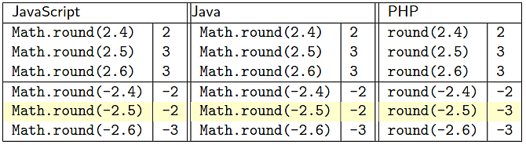
BEWARE OF ROUNDING
Rounding is an arithmetic operation commonly included in programming languages, but with different implementations:

Slide 20
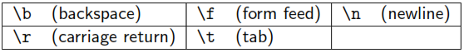
STRING
In JavaScript a string literal is a sequence of characters surrounded by single-quotes or double-quotes.
The escape character \ can be used to include single quotes in single-quoted strings and double quotes in double-quoted strings:
The escape character \ also must be used to include \ in a string
Additional escape characters are available, but do not make much sense in the context of HTML

Slide 21
STRING
JavaScript uses + for string concatenation
String properties: constructor, length, prototype
String Methods: str.indexOf( ), str.search( ), string.slice( ), string.substr( ), string.match( ), string.replace( ), string. toUpperCase( ), string. toLowerCase( ), string.concat( ), string.trim( )

Slide 22
UNDEFINED AND NULL
Dalam JavaScript, variabel tanpa nilai, memiliki nilai undefined. Jenisnya juga undefined. Variabel apa pun dapat dikosongkan, dengan menyetel nilainya menjadi undefined.
Null tidak ada hubungannya dengan undefined.
Undefined dan null memiliki nilai yang sama tetapi jenisnya berbeda.

Slide 23
STORING VALUE

Slide 24
VARIABLES
Variables can be declared (within an execution context) using one of the following statements
A declaration does not specify the type of a variable. The second statement also initializes the variables.
It is good practice to always declare variables
Identifiers digunakan untuk memberi nama variabel. karakter pertama harus berupa huruf, atau garis bawah (_), atau tanda dolar ($). Identifiers bersifat case sensitive.
Notes:
Dalam contoh ini, x didefinisikan sebagai variabel (deklarasi). Kemudian, x diberikan (diberikan) nilai 6 (inisiasi):
(dan kata kunci, fungsi, dan label). karakter pertama harus berupa huruf, atau garis bawah (_), atau tanda dolar ($). Peka Huruf Besar-Kecil

Slide 25
VARIABLES
A variable can be initialised without an explicit declaration by assigning a value to it.
A declared but uninitialised variable has the default value undefined and has type undefined.
A variable that is neither declared nor initialised will result in a reference error and execution of the program stops.

Slide 26
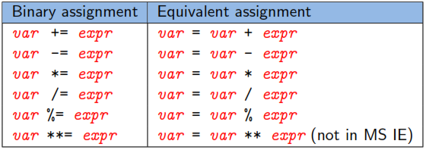
ASSIGNMENTS
JavaScript uses the equality sign = for assignments
JavaScript supports most of the standard binary assignment operators:

Slide 27
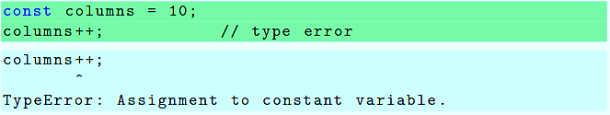
CONSTANT
Some JavaScript dialects allow the definition of constants using
constants follow the same scope rules as variables
Attempts to change the value of a constant should result in a type error

Slide 28
TYPE CONVERSION

Slide 29
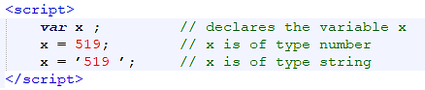
TYPE SYSTEM
Most programming languages categorize values and operations according to type. The type of a JavaScript variable does not need to be declared.
JavaScript is a dynamically and loosely typed language
Dynamically typed programming language: type checking is performed during program execution when statements are executed / expressions are evaluated
Loosely/Weakly typed programming language: A value of one type can be treated as being of another type (or is automatically converted to the type required by an operation)
The type of a variable depends on the value it currently stores. Ini berarti variabel yang sama dapat digunakan untuk menampung tipe data yang berbeda.
Notes:
Statically typed programming language: Type checking is performed before program execution, e.g., by a compiler
Strongly typed programming language: Each value has exactly one type and operations can only be applied to argument values of the correct type

Slide 30
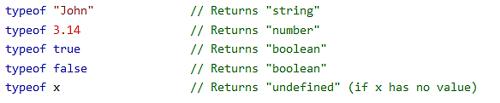
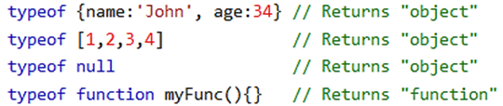
TYPE CHECKING
You can use the JavaScript typeof operator to find the type of a JavaScript variable.
The typeof operator returns the type of a variable or an expression.
Notes:
Undefined dan null
Persamaan: sama2 tidak punya nilai.
Perbedaan: undefined tipenya undefined, null tipenya objek

Slide 31
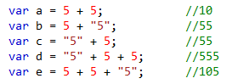
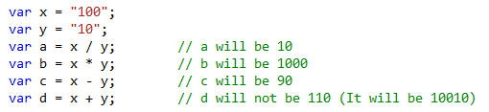
TYPE COERCION
JavaScript automatically converts a value to the appropriate type as required by the operation applied to the value.
Adding a number and a string will return a string. The JavaScript interpreter works from left to right.
JavaScript will try to convert strings to numbers in all numeric operations
Notes:
If you add two numbers, the result will be a number.
If you add two strings, the result will be a string concatenation

Slide 32
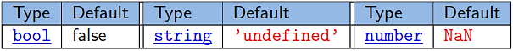
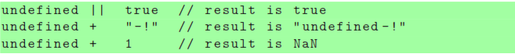
TYPE COERCION
The value undefined is converted as follows.
When converting to boolean, the following values are considered false:
the number 0 (zero), the empty string, but not the string ’0’, undefined, null, NaN
Every other value is converted to true, including:
Infinity, ’0’, functions, objects (in particular, arrays with zero elements)
Notes:
If you add two numbers, the result will be a number.
If you add two strings, the result will be a string concatenation

Slide 33
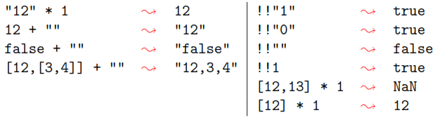
TYPE CASTING
Type casting is when you assign a value of one data type to another type. JavaScript provides several ways to explicitly type cast a value.
Apply an identity function of the target type to the value

Slide 34
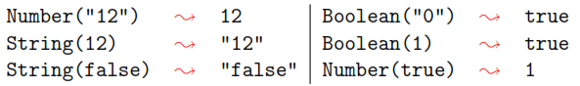
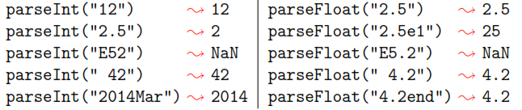
TYPE CASTING
Wrap a value of a primitive type into an object. JavaScript has objects Number, String, and Boolean with unary constructors/wrappers for values of primitive types.
Use parser functions parseInt or parseFloat

Slide 35
COMPARISON OPERATORS
Notes:
Perbandingan dan Operator logika digunakan untuk menguji trueatau false.

Slide 36
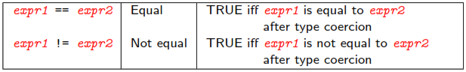
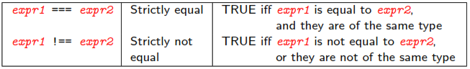
COMPARISON OPERATORS
Comparison operators are used in logical statements to determine equality or difference between variables or values, menghasilkan nilai true atau false.
JavaScript distinguishes between (loose) equality == and strict equality ===

Slide 37
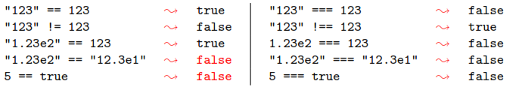
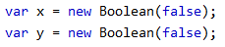
COMPARISON OPERATORS
JavaScript’s comparison operators also apply type coercion to their operands and do so following the same rules as equality ==
When comparing a number and a string, the string is converted to a number. An empty string converts to 0. A non-numeric string converts to NaN which is always false.
When comparing number with a boolean, the boolean is converted to 1 if true and to 0 if false
If an object is compared with a number or string, JavaScript uses the valueOf and toString methods of the objects to produce a primitive value for the object
Objects cannot be compared. If two objects are compared, then the equality test is true only if both refer to the same object
“1.23e2”
Notes:
An empty string converts to 0. A non-numeric string converts to NaN which is always false.
https://www.w3schools.com/js/js_comparisons.asp

Slide 38
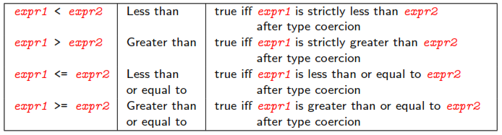
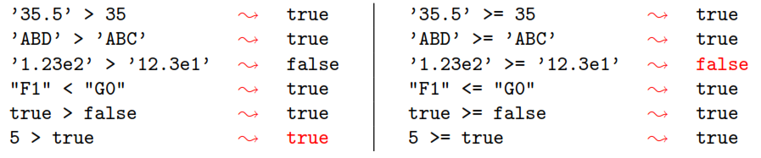
COMPARISON OPERATORS
Notes:
Pertidaksamaan
When comparing two strings, "2" will be greater than "12", because (alphabetically) 1 is less than 2.
https://www.w3schools.com/js/js_comparisons.asp

Slide 39
CONTROL STRUCTURE

Slide 40
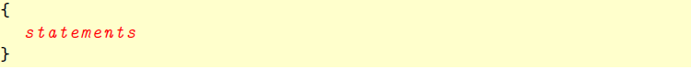
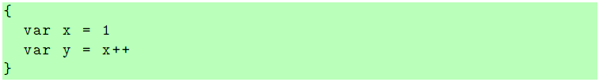
BLOCK STATEMENT
A block statement is a sequence of zero or more statements delimited by a pair of curly brackets
It allows to use multiple statements where JavaScript expects only one statement

Slide 41
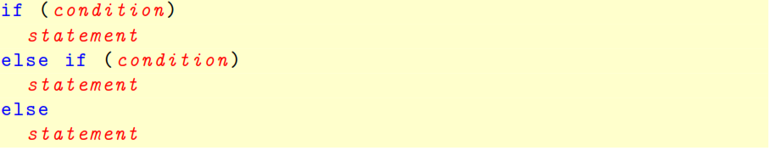
CONDITIONAL STATEMENT
Conditional statements take the following form in JavaScript:
The else-clause is optional but there can be at most one
Each statement can be a block statement

Slide 42
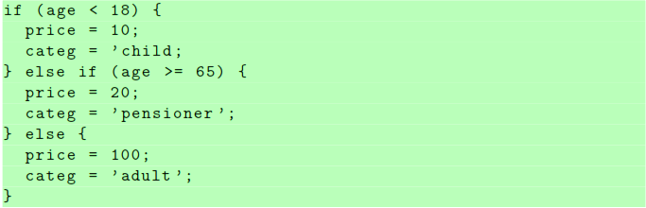
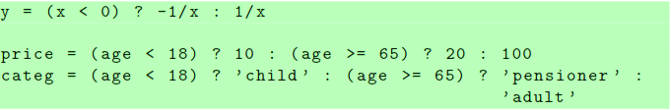
JavaScript also supports conditional expressions

Slide 43
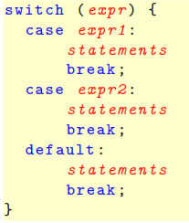
SWITCH STATEMENT
there can be arbitrarily many case-clauses
the default-clause is optional but there can be at most one
expr is evaluated only once and then compared to expr1, expr2, etc using (loose) equality ==
once two expressions are found to be equal the corresponing clause is executed
if none of expr1, expr2, etc are equal to expr, then the default-clause will be executed
break ‘breaks out’ of the switch statement
if a clause does not contain a break command, then execution moves to the next clause

Slide 44
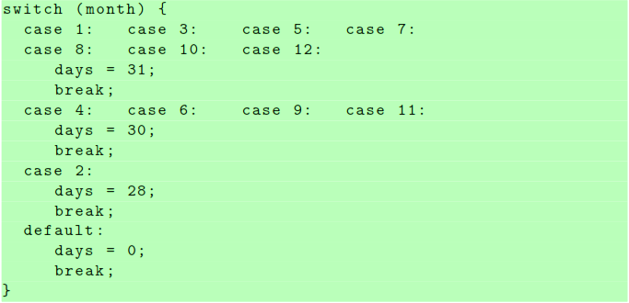
SWITCH STATEMENT
Not every case-clause needs to have associated statements

Slide 45
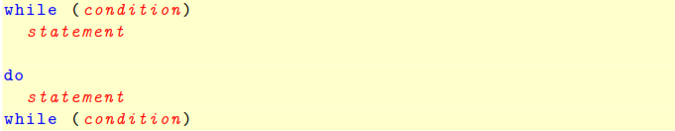
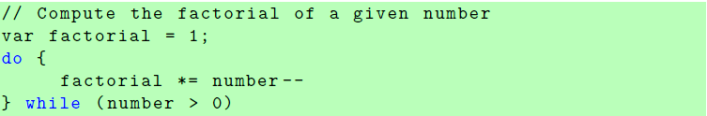
LOOPS
JavaScript offers while-loops and do while-loops

Slide 46
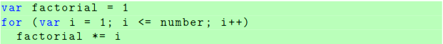
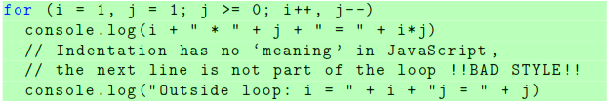
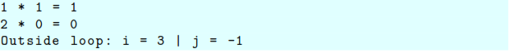
LOOPS
for-loops in JavaScript take the form
In JavaScript, initialization and increment can consist of more than one statement, separated by commas instead of semicolons.

Slide 47
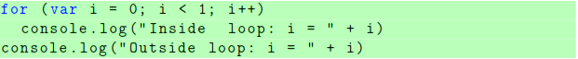
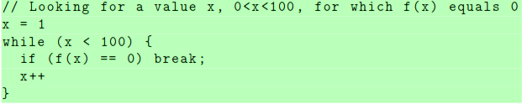
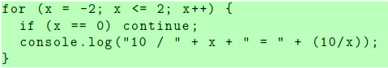
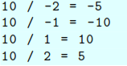
LOOPS
Note: Variables declared with var inside a for-loop are still visible outside
The break command can also be used in while-, do while-, and for-loops and discontinues the execution of the loop
The continue command stops the execution of the current iteration of a loop and moves the execution to the next iteration

Slide 48
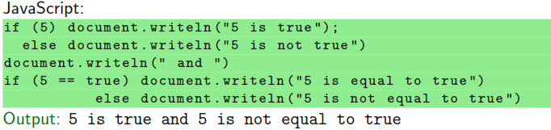

EQUALITY AND PROGRAM BEHAVIOUR
Why do we care whether 5 == true is true or false?
it influences how our scripts behave
it influences whether more complex objects are equal or not
https://www.w3schools.com/js/js_type_conversion.asp

Slide 49
ERROR HANDLING
Try.. Catch..
The try statement allows you to define a block of code to be tested for errors while it is being executed. The catch statement allows you to define a block of code to be executed, if an error occurs in the try block.
Throw
The throw statement lets you create custom errors. you can control program flow and generate custom error messages, can be a JavaScript String, a Number, a Boolean or an Object.
Finally
The finally statement lets you execute code, after try and catch, regardless of the result.
Notes:
The JavaScript statements try and catch come in pairs:

Slide 50

ERROR HANDLING

Slide 51
REFERENSI
Materi disadur dari: 1. COMP519 Web Programming (2020-21). Diakses pada Januari 2021, dari https://cgi.csc.liv.ac.uk/~ullrich/COMP519/ 2. W3Schools Online Web Tutorials. Diakses pada Januari 2021, dari https://www.w3schools.com/

Slide 52
Responsi
Mengapa perlu mempelajari Javascript dalam pemrograman web?
Apa maksud dari javascript sebagai dynamically dan weakly typed programming? Jelaskan!
File pdf diupload sebagai responsi untuk absensi di Classroom paling lambat pada akhir sesi.

Slide 53

Thanks!
Do you have any questions?
wilantika@stis.ac.id
lya@stis.ac.id
yeni.rima@stis.ac.id

